Slide 1
Depth First Search
Introduction to Graph Theory

Slide 2
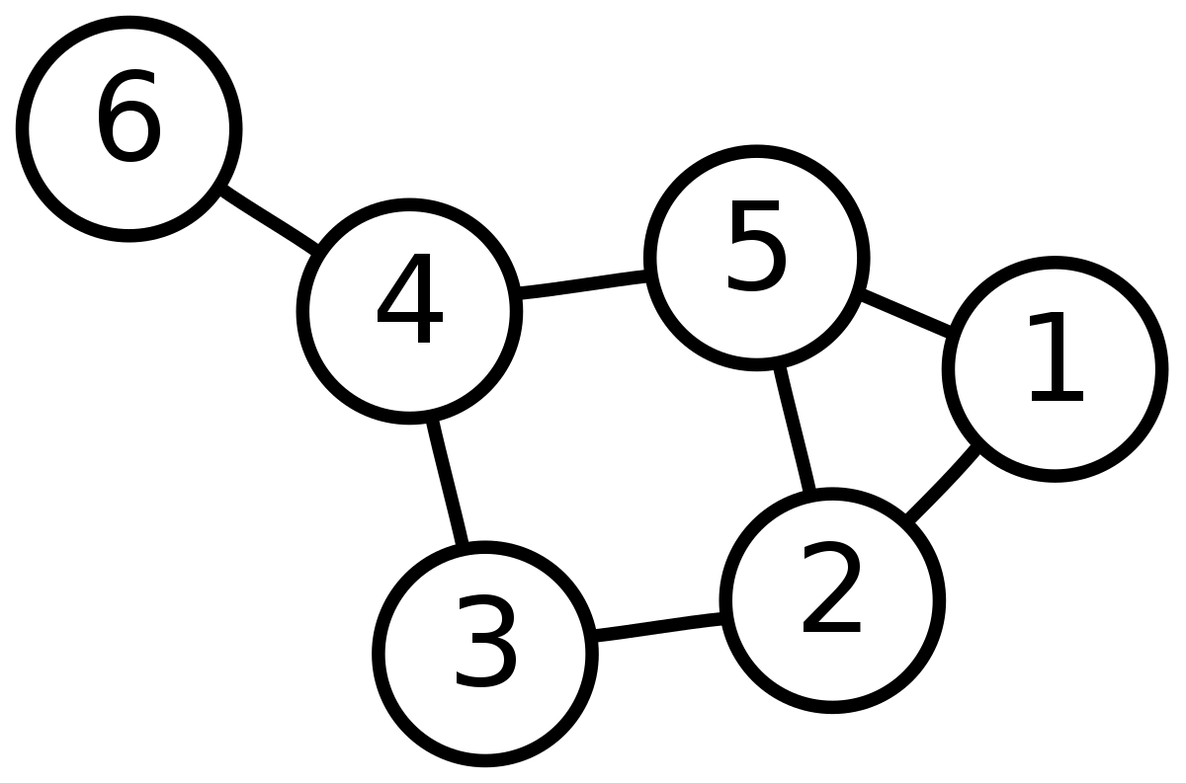
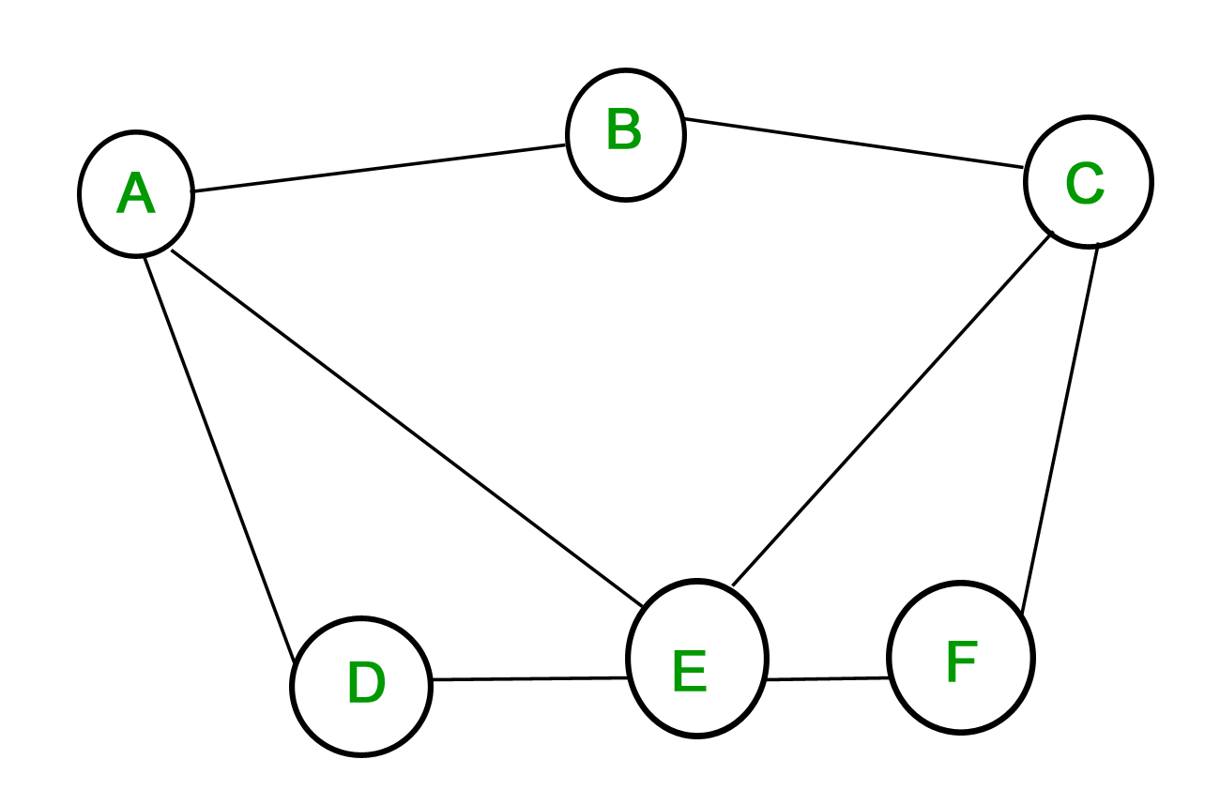
Introduction to Graphs
Graphs can be visualized as a network of circles and lines connecting these circles
Nodes: the term to refer to these circles
Edges: represents the lines connecting these nodes
Two types of graphs
Undirected Graphs
The edges can be traversed both ways <------>
Directed graphs
Edges can only be traversed one way
We say a graph is connected if you can start at any node and reach any other node in the graph

Slide 3
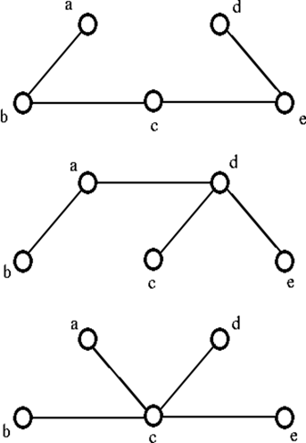
Trees
Also known as a connected acyclic undirected graph
Acyclic: a graph without a cycle
Cycle: a non-empty path where the first and last nodes visited are the same
N nodes, N-1 edges
There are two types of nodes:
Child node: the nodes that branch off from the current node
Parent node: the node that you originally came from
Root Node: starting node (where you start your traversal)
Leaf Node: nodes that do not have any child nodes

Slide 4
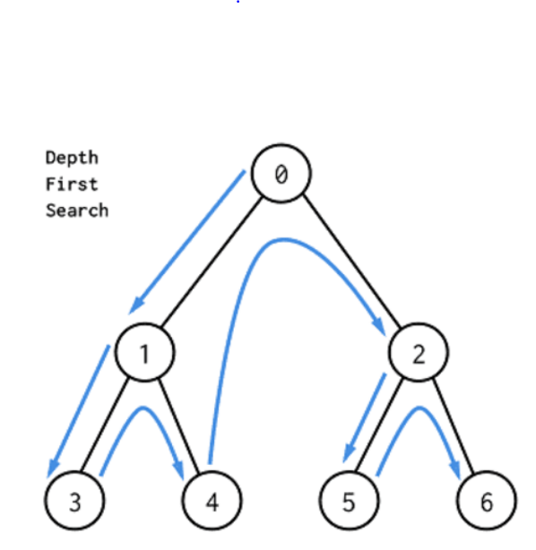
DFS Basics
Depth First Search
Explores as far down a path as possible before going backwards
Marks nodes as visited to avoid getting stuck in a cycle
Store edges in an adjacency list (array with arraylists)

Slide 5
Iterative DFS
stack<int> nodes
nodes.push(rootNode)
while(!nodes.empty()){ int nextNode = nodes.top();
nodes.pop();
if(!vis[nextNode]){
print nextNode
vis[nextNode] = true
} else {
continue
}
for(int i: adj[nextNode]){
if i not visited {
nodes.push(i);
}
}
}

Slide 6
Recursive DFS
In any graph:
int dfs (int u)
vis[u] = true
for int v in adj[u]
if v is not visited
dfs(v)
In a tree:
int dfs (int u, int p)
for int v in adj[u]
if v not equal to p
dfs(v, u)

Slide 7
Problems
https://dmoj.ca/problem/vmss7wc16c3p2
https://dmoj.ca/problem/vmss7wc16c5p3
https://dmoj.ca/problem/nccc5j5s3

